Slide 1

AAMB & Co.
MARKET ANALYSIS -AIRBNB CAPE TOWN
AAMB & Co.
SINCE 2024
EXPERTS AT CONSULTANCY & MARKET ANALYSIS
Notes:
MARIA

Slide 2
AAMB & Co.
OUR TEAM
SINCE 2024
BADER
MARIA KHALIFA
ALI AMMAR
AFRAH
Notes:
MARIA

Slide 3

TABLE OF CONTENTS
·01·
·02·
·03·
AAMB & Co.
DATA OVERVIEW
MARKET ANALYSIS
BEST PROPERTY FOR INVESTMENT
·04·
LIMITATIONS/SUGGESTIONS
SINCE 2024
Notes:
MARIA: WE WILL MOVE THROUGH THE FOLLOWING TOPICS

Slide 4

AAMB & Co.
·01·
DATA OVERVIEW
SINCE 2024
Notes:
MARIA – I will be explaining the data we have used to create our analysis

Slide 5
HOTEL CHAIN
DATA OVERVIEW
SINCE 1930
·1·
·2·
·3·
·Data Scraped On Date·
·Null Data·
· No. of Listings ·
29 & 30 June 2024
16317
Listing without prices removed.
Listings without reviews have been removed.
Notes:
MARIA– Important things to note is that we worked on data scraped on 29&30June with total number of listings of 16317. We have removed the listings without prices and listings without reviews as well because they generally tend to be overpriced and there were previous bookings. The host could book his own property to indicate greater demand.

Slide 6

AAMB & Co.
MARKET ANALYSIS
SINCE 2024
In depth analysis of the current market for better AIRBNB investment recommendations.
Notes:
AFRAH – We will go through the key pointers that we found through our market analysis which also helped us in UNDERSTANDING which property would be the best investment in the city of cape town

Slide 7

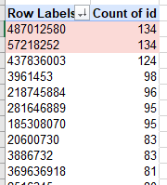
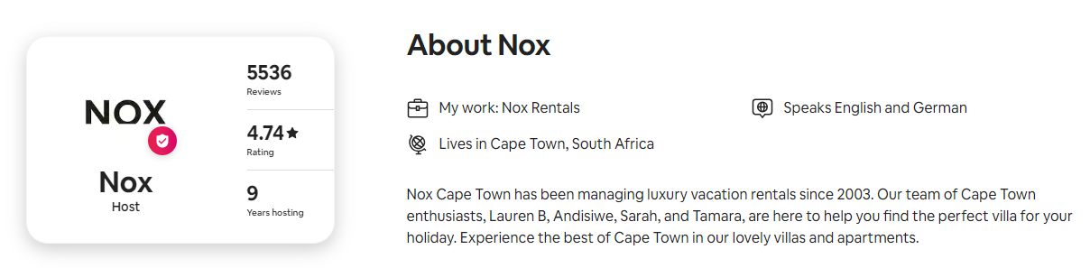
WHICH HOSTS HAVE HIGHEST NO. OF RENTAL PROPERTIES?
HOST ID - 487012580
HOST ID - 57218252
Notes:
AFRAH: explain that we showed a snippit of the two top listings of host ID’s profile from the Airbnb and website

Slide 8
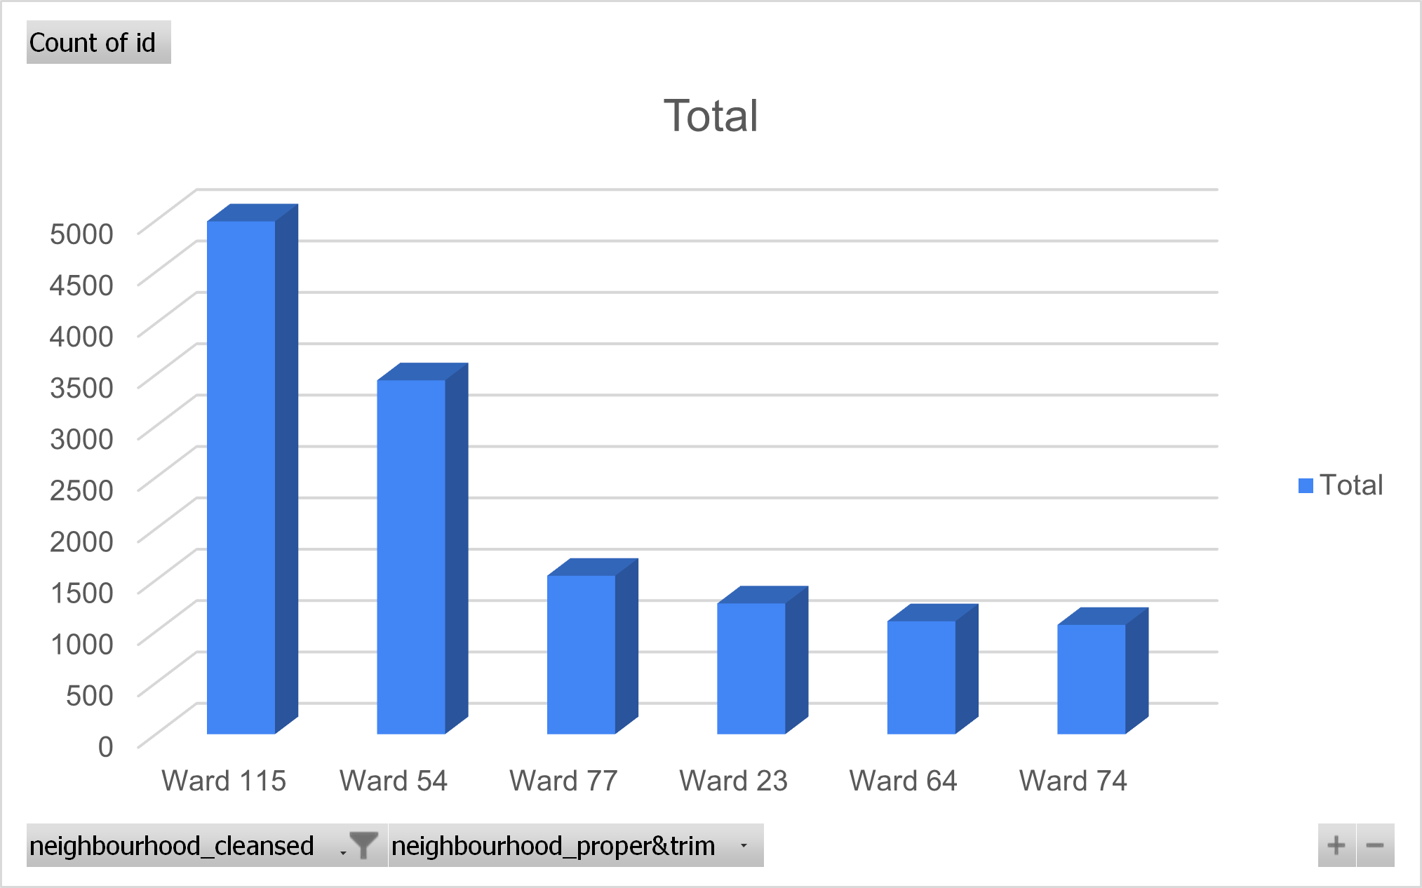
WHICH NEIGHBORHOODS HOST THE MOST LISTINGS?
Notes:
AFRAH – mention top 3 wards

Slide 9
WHICH PROPERTY TYPES RECEIVE THE MOST POSITIVE REVIEWS?
Notes:
MARIA

Slide 10
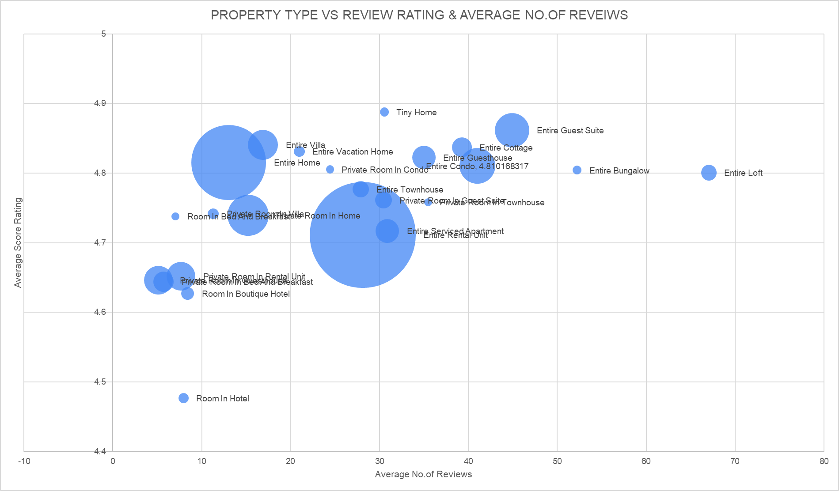
Notes:
MARIA

Slide 11
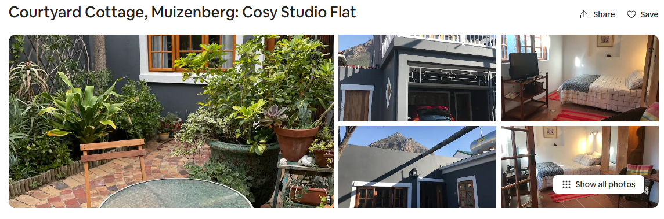
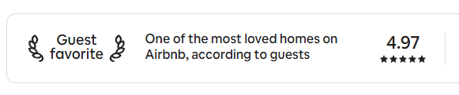
WHICH PROPERTY TYPES RECEIVE THE MOST POSITIVE REVIEWS?
AAMB & Co.
TINY HOUSE
Avg. Review Rating – 4.89
Avg. No. of Reviews - 70
SINCE 2024
Notes:
maria

Slide 12
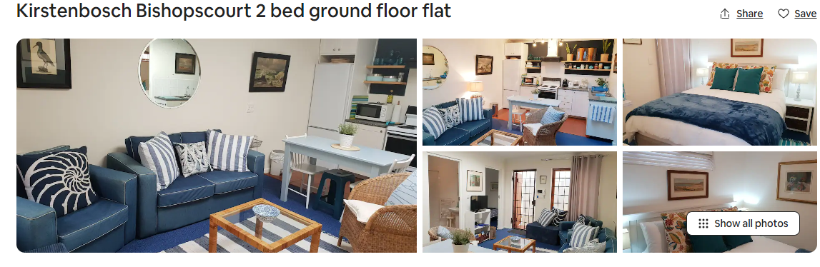
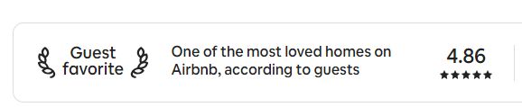
WHICH PROPERTY TYPES RECEIVE THE MOST POSITIVE REVIEWS?
AAMB & Co.
ENTIRE GUEST SUITE
Avg. Review Rating – 4.86
Avg. No. of Reviews - 1013
SINCE 2024
Notes:
maria

Slide 13
HOW MUCH REVENUE DO SUCCESSFUL HOSTS GENERATE?
Notes:
bader

Slide 14
OUR PROCESS
AAMB & Co.
·01·
·03·
REVENUE
RESULT!
NO. OF BOOKINGS
·02·
HOST ID
·04·
SINCE 2024
Notes:
bader

Slide 15
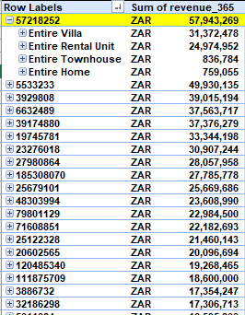
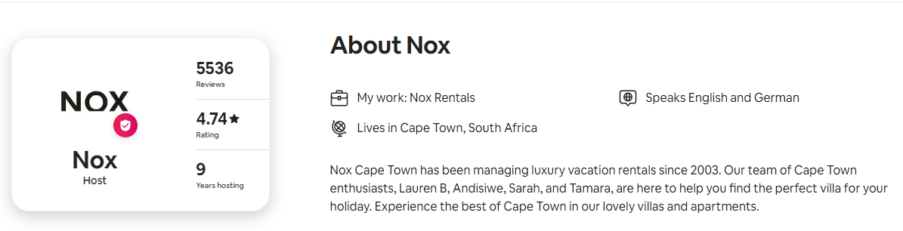
HOW MUCH REVENUE DO SUCCESSFUL HOSTS GENERATE?
HOST ID: 5721852
REVENUE NEXT 12 MONTHS: ZAR 57,943,269
Notes:
bader

Slide 16
AAMB & Co.
INVESTMENT RECOMMENDATION
SINCE 2024
Notes:
ali

Slide 17
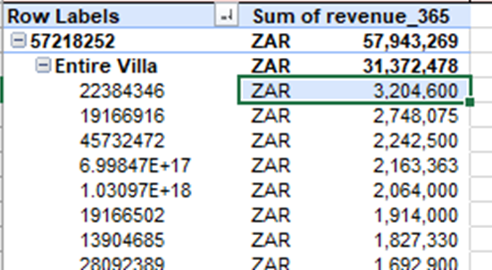
ROAD MAP TO BEST INVESTMENT
HOST ID
HIGHEST REVENUE
PROPERTY TYPE
MAX. REVENUE
MAX. REVENUE
LISTING ID
RESULT: LISTING ID#22384346
Notes:
ali

Slide 18


RECOMMENDED INVESTMENT: Modern Villa with Rooftop Deck & Table Mountain Vi
Listing ID: 22384346
Avg. Review Score Rating: 4.83 with 24 Reviews
Host Name: Nox
ID#57218252 (has highest no. of listings)
3 Baths
4 Bedrooms
4 Beds
8 Guests
Property Type:
Entire Villa
Ward 77 – 3rd Highest Listings
Notes:
ALI

Slide 19
LIMITATIONS/SUGGESTIONS
AAMB & Co.
SINCE 2024
Notes:
ALI – EXPLAIN THE ISSUE OF INVESTMENT BEING BASED ON WHICH STRATEGY THE CLIENT IS GOING FOR

Slide 20

AAMB & Co.
THANK YOU!
SINCE 2024
Notes:
ALI – CONCLUDE THE PRESENTATION

